Slide 1
Lecture 2: History of Money and Finance
Perry Mehrling
Warsaw School of Economics
October 12, 2016

Slide 2
Two traditions
“There were, at the least, two strands in classical economics. There was one (represented, roughly speaking, by Ricardo and his followers) which maintained that all would be well if by some device credit money could be made to behave like metallic money; there was another (represented, so far as I have taken the story, by Thornton and Mill) which held that credit money must be managed, even though (as was admitted) it is difficult to manage it. This is a major difference, and it has outlasted Keynes.”
Hicks 1967, “Monetary Theory and History”

Slide 3
Drivers
World Wars, World Depression, Rise of Welfare State, Stabilization Policy
Rise of the United States (1913 Fed, 1944 Bretton Woods), from sterling to dollar reserve
Professionalization of Economics, Formal Turn in Economics, Econometric Movement
De-colonization, Independence, Financial Crisis
Emerging Markets, Financial Globalization, Global Financial Crisis

Slide 4
The Money View
Banking as a Payments System
Copeland (1952): A Moneyflow Economy
Minsky (1957): The Survival Constraint
Banking as a Market Making System
Hawtrey (1919): Hierarchy of Money and Credit
Hicks (1989): Centrality of the Dealer Function
Bagehot (1873): Dealer of Last Resort

Slide 5
The Economics/Finance View
MV=PT, money as means of exchange
IS-LM (nominal interest rate), money as store of value
Purchasing Power Parity, P=sP* (FX), money as measure of value
DSGE with Taylor Rule (inflation targeting)

Slide 6
Finance and Macroeconomics
U’(C_{it}) = E_{t}[δU’(C_{it+1})R_{jt+1}]
Finance: “consumption CAPM”
Economics: “Real Business Cycles”

Slide 7
Fatal Abstractions
No “Banking as a Payment System”
No Money Flow, NIPA
No Survival Constraint, Budget Constraint
No “Banking as a Market-Making System”
No Hierarchy, Money as n+1th market
No Dealers, Price equilibrates supply and demand
No Dealer of Last Resort, Central Bank operates on inflation expectations

Slide 8
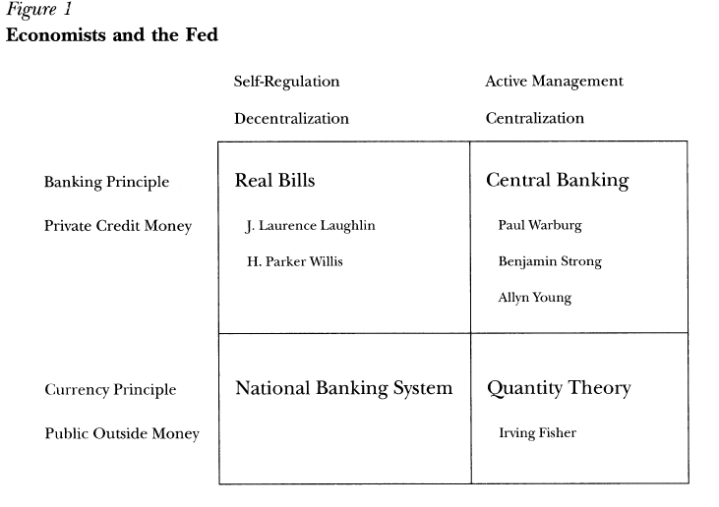
Monetary Thought, 1913

Slide 9
Political Economy, 1913
Three Bogeymen
Big Finance Memory of 1907 Crisis (JP Morgan)
And 1910 (Jekyll Island)
Big Government Memory of 1862 (Greenbacks)
Big Wide World Actuality of Sterling System
Political Solution
Real Bills Language (vs. Finance and Government)
Gold Convertibility (vs. Wide World)
Board of Governors, democratic oversight
Funding Liquidity vs. Market Liquidity

Slide 10
Language vs. Reality
Funding liquidity versus market liquidity
Real bills doctrine, self-liquidating bills
Shiftability doctrine, Moulton 1918
Primitive repo, Primitive shadow banking!
Wartime transformation
Centrality of government debt (Bogey #2)
Centrality of government debt dealers (Bogey #1)
Tenth Annual Report (1923)
Invention of open market operations

Slide 11
Great Depression Transformation
Federal Reserve failure
1931 lender of last resort but not dealer of last resort (funding liquidity, not market liquidity)
Federal Reserve transformation
Banking Act of 1935, “apotheosis of shiftability”
Banking Act of 1937, “orderly conditions” tantamount to dealer of last resort, essential hybridity

Slide 12
Emerging Norms of Management
Keynes 1930 Treatise, normal backwardation
Keynes 1936 GT, liquidity preference
Hicks 1939, V&C, forward rate bias
Wartime hiatus, and more transformation
From war finance to Bretton Woods 1944 (Bogey #3)
From war finance to Fed-Treasury Accord 1951
FOMC “Report of the Ad Hoc Subcommittee on the Government Securities Market” (1952)
Level of interest rates
“Tone” of the money market, centrality of private dealers

Slide 13
Capital Finance, indirect
 | Capital Market | Federal Reserve | Banking
Money | Repo | Rate Target | Fed Funds
 | Commercial Paper | Treasury Bills | C&I lending
Credit | Corporate Bonds | Treasury Bonds | Mortgage lending

Slide 14
International Dollar, indirect
 | Asia | US | Europe
Key Currency |  | Dollar
National Currency | Yen, Renminbi | International Dollar | DM, Euro
National Deposits, National Credit

Slide 15
Origins of Macroeconomics?
Alvin Hansen
Continental Business Cycles (Schumpeter) +
American Institutionalism (Burns/Mitchell)
John Maynard Keynes
English Banking Traditions (Tooke, Bagehot, Marshall, Hawtrey)
James Tobin: neoclassical synthesis
Irving Fisher (Walrasianism) +
Cambridge Quantity equation

Slide 16
Evolution of Macro?
Internal Inconsistency, Monetarist Challenge
Phelps (1968), Friedman (1968), Muth (1961)
New Classical Theory (Lucas 1975, 1976, 1977)
“Equilibrium Model of the Business Cycle”
“Econometric Policy Evaluation”
“Understanding Business Cycles”
Real Business Cycles
Kydland and Prescott (1982)
Long and Plosser (1983)

Slide 17
The Lucas Link: Macro vs. Finance
“On the one hand, it is easy to postulate agents and market institutions which ignore or foolishly waste information: the result is a theory which seriously understates agents’ abilities to vary their decision rules with changes in the environment (such as, for example, the theory underlying the major econometric forecasting models). It is equally easy to postulate ‘efficient’ securities markets which rapidly transmit all information to all traders: the result is a static general equilibrium model. To observe that one must avoid both extremes to understand the business cycle does not take one very far in discovering the correct ‘centrist’ model, but it seems nonetheless an essential point of departure.” (Lucas 1975, 1138).

Slide 18
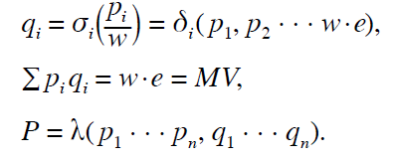
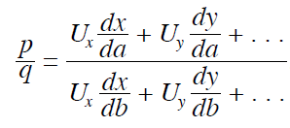
Rise of the Academics
Marschak 1934 (Classical?)
Marschak 1938 (Neoclassical?)

Slide 19
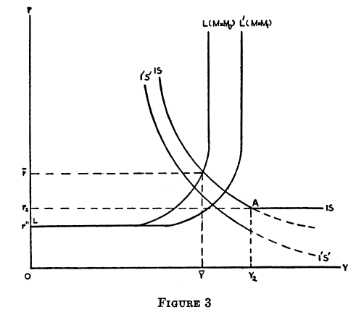
Modigliani
“Liquidity Preference and the Theory of Interest and Money” (1944)

Slide 20
Samuelson (1947 [1937])
Robertson’s Money (1922)
Monetary Walrasianism
Hicks 1935 “A suggestion for simplifying…”
Marschak 1938 “Money and the theory of assets”
M = M(p₁,….,p_{n},p_{m},I,r)
Monetary theory of the rate of interest? NO
Liquidity preference theory of term structure? NO
Neoclassical Synthesis (1955, 1967)

Slide 21
An Aside on Hicks
Repudiation of 1937 “Keynes and the Classics”, but not 1935 “Simplifying”
1962 Presidential Address “Liquidity” restarts his monetary inquiry, culminating in 1989 Market Theory of Money
Not monetary Walrasianism, rather completion of Keynes Treatise on Money
Hicks and the money view

Slide 22
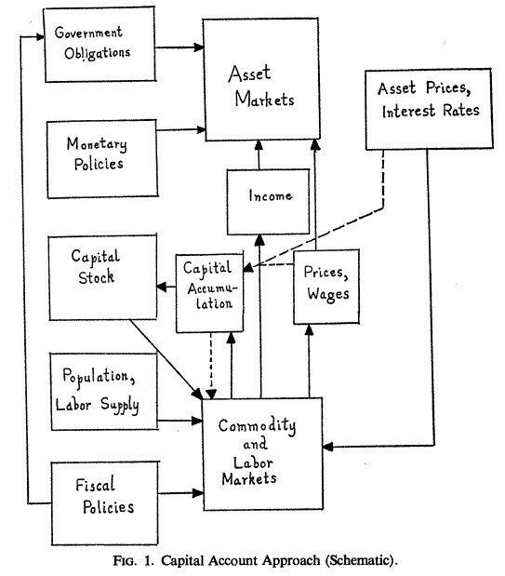
Emerging Norms of Management
Tobin 1969
Modigliani 1975

Slide 23
State of Debate circa 1975
 | Self-regulation Decentralization | Active Management Centralization
Banking School Private Credit Money | Fischer Black ‘75 | Charles Kindleberger ‘48
Currency School Public Outside Money |  | Franco Modigliani ‘62

Slide 24
Can Monetary Policy Work?
“If the interest rate on money, as well as the rates on all other financial assets, were flexible and endogenous, then ….there would be no room for monetary policy to affect aggregate demand.”
Tobin (1969, 26)

Slide 25
Monetarism Mark I
“One can see why the initial monetarist tide was so successful – no one had thought of building any dykes.”
Hahn on neoclassical “synthesis” (1983, 51) in Paul Samuelson and Modern Economic Theory

Slide 26
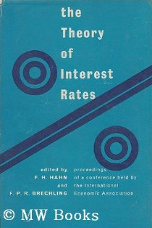

The “Hahn Problem”
Hahn 1965
Woodford 2003

Slide 27
The Problem of Time
Economics View
Finance View
Past → Present
Capital Stock K
Y=f(K,L)
Future → Present
Capital value P_{K}
P_{K} = E₀∑(1/1+r)^{t}C_{t}

Slide 28
Rise of Finance
CAPM Origins [Marschak 1938]
Markowitz (1956) to Sharpe (1964)
Modigliani-Miller (1958) to Treynor (1962)
Options Pricing Origins
Treynor to Black-Scholes (1973)
Samuelson to Merton (1973)

Slide 29
“Monetarism” Mark II
Black (1970) “Banking in a World Without Money”
Real Business Cycles
Kydland and Prescott (1982)
Long and Plosser (1983)
Dynamic Stochastic General Equilibrium Model
No banks, no money, liquidity as a free good
Price level formed by “expectations” and Central Bank Taylor Rule

Slide 30
Risk control in efficient markets
Euler Equation:
U’(C_{it}) = E_{t}[δU’(C_{it+1})R_{jt+1}]
Finance: portfolio choice
0 = E_{t}[M_{it+1}(R_{jt+1}-R_{j’t+1)}]
Macroeconomics: monetary policy
y_{t} = E_{t}y_{t+1} – σ(i_{t} – E_{t}π_{t+1}) + g_{t}

Slide 31

Special Theories of “Liquidity”
Diamond and Dybvig (1983) “Bank Runs, Deposit Insurance, and Liquidity”
Holmstrom and Tirole (1998) “Private and Public Supply of Liquidity”

Slide 32
The Problem of Time, Redux
Finance View
Money View
Future → Present
Capital value P_{K}
P_{K} = E₀∑(1/1+r)^{t}C_{t}
Present → Present
Cash Flow
Survival Constraint

Slide 33
The Money View
Banking as a Payments System
Copeland (1952): A Moneyflow Economy
Minsky (1957): The Survival Constraint
Banking as a Market Making System
Hawtrey (1919): Hierarchy of Money and Credit
Hicks (1989): Centrality of the Dealer Function
Bagehot (1873): Dealer of Last Resort

Slide 34
“Capitalism is essentially a financial system” (1967)

Slide 35
The Vision of Minsky (1999)
“By his own reckoning, Minsky was an institutionalist economist in the sense that he viewed the structure of the economic world not as immanent in some set of underlying data—such as endowments, technology, and preferences—but rather as constituted by a set of key economic institutions. He was institutionalist too in his insistence that our economy is essentially, not incidentally, monetary in character. His way of fleshing out that idea was to look at every economic unit—firms, households, governments, even countries—as though it were a bank daily balancing cash inflow against cash outflow. From that point of view, the categories that most economists, and most people, take to be solid simply melt into air. Production, consumption, and trade, are nothing more than flows of money in and out and between different economic units. The most real thing is money, but money is nothing more than a form of debt, which is to say a commitment to pay money at some time in the future. The whole system is therefore fundamentally circular and self-referential. There is nothing underneath, as it were, holding it up. In Minsky’s hyper-modern institutionalism, institutions do not merely organize the stuff of some pre-existing real world; there are the only real world there is. Financial relationships are not about mediating something else on the ‘real’ side of the economy; they are the constitutive relationships of the whole system. The veil of money is the very fabric of the modern economy.”

